Slide 1

SoECE
Operating system and
Embedded system Design
Students Details:
Sl. No | Name | USN
1. | Murari | 01FE20BEC084
2. | Anand Doddamani | 01FE20BEC102
3. | Nitish D Kulkarni | 01FE20BEC111
4. | D S Sanjaya | 01FE20BEC115
Under the Guidance of:
Prof. Rohini Hongal

Slide 2
SoECE
Contents:
Introduction to Real Time Operating System(RTOS)
Problem Statement
Code analysis
Simulation
5) conclusion

Slide 3
SoECE
Introduction to RTOS
A real-time operating system (RTOS) is an operating system (OS) for real-time applications that process data and events that have critically defined time constraints.
There are different types of OS such as stand-alone OS, Network OS, Embedded OS.
OS acts as a bridge between the user commands and the hardware.
Some of the main functionalities of an OS are as follows :
Process management
Memory management
File management
Accounting
Communication
Error detection
Here process management is one of the important aspects of an OS, there are different algorithms that have been adopted for the particular type of issue.
Some of them are First come first serve(FCFS), Round robin, Shortest Job First(SJF), and priority scheduling.

Slide 4
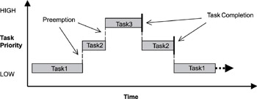
SoECE
Introduction to RTOS
Preemptive Priority-Based Scheduling :
Real-time kernels generally support 256 priority levels, where 255 is the highest and 0 the lowest.
With a preemptive priority-based scheduler, each task has a priority, and the highest-priority task runs first.
If a task with a priority higher than the current task becomes ready to run, the kernel immediately saves the current task s context in its TCB and switches to the higher-priority task.

Slide 5
SoECE
Write an RTOS code to perform the following tasks using Priority Scheduling Algorithm:-
Task 1: Interrupt Count
Task 2: UART Display
Task 3: If the count is even then beep the Buzzer twice else beep the buzzer once.
Explanation:
Here as per the given problem statement, there are three tasks that have to be done using a priority scheduling algorithm. This means each task will be given some priority number according to which it should run the tasks.
At first Task 1 will run i.e it will keep the count of an interrupt that has occurred.
The very next task would be to display the count on an uart.
At last, if the count is even then the buzzer should beep two times and if it’s odd then it should beep for only one time.

Slide 6
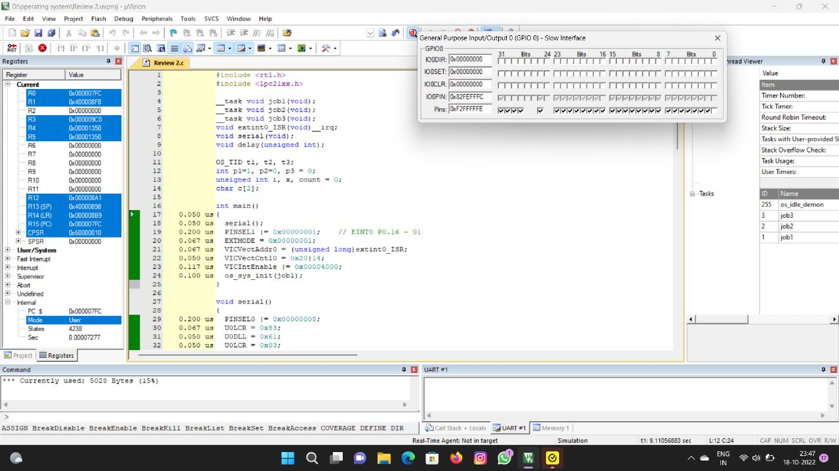
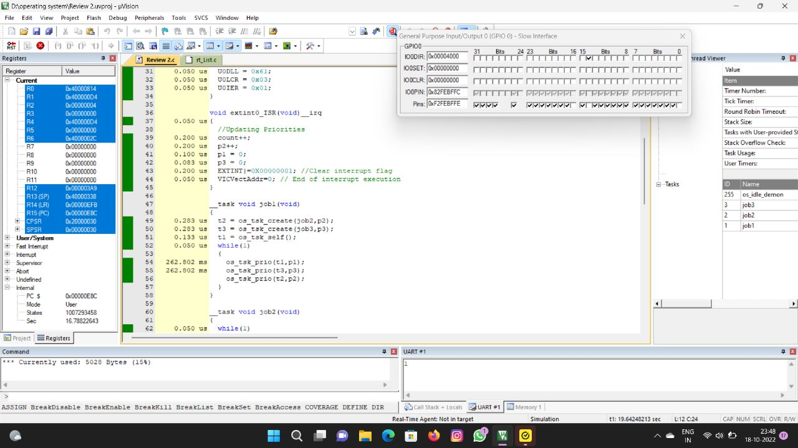
SoECE
Code Analysis:

Slide 7
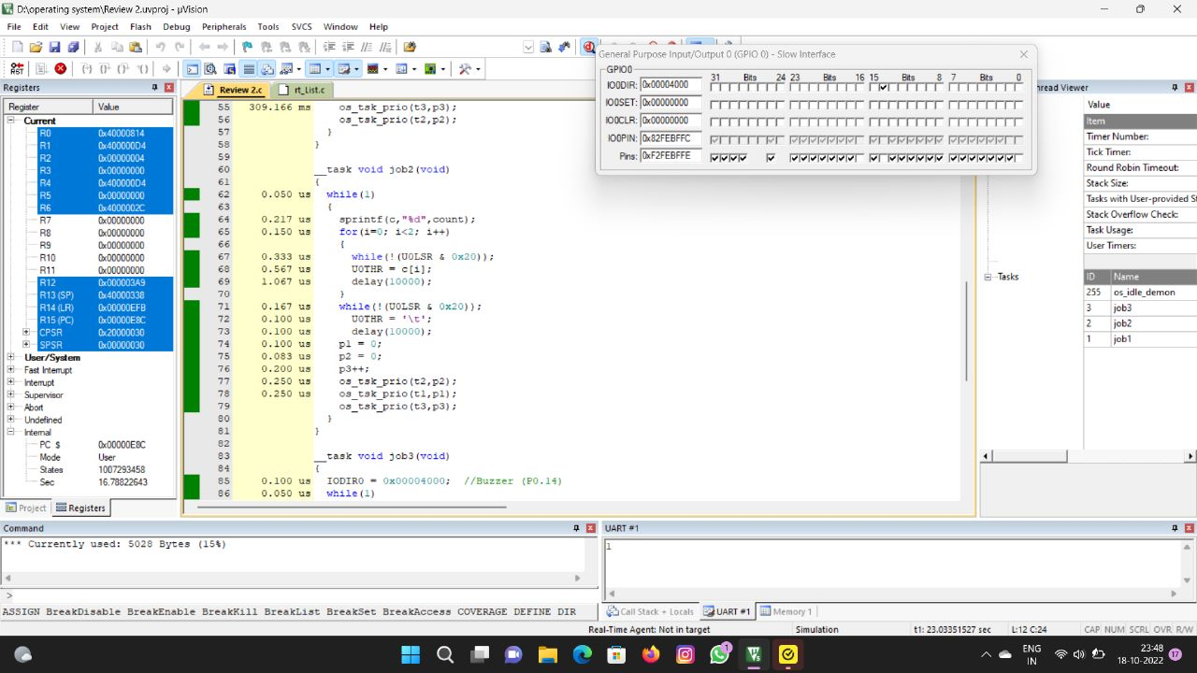
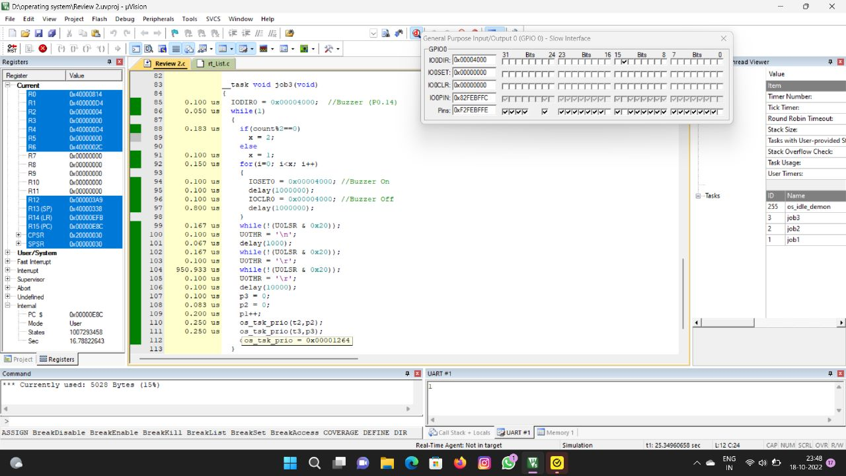
SoECE
Code Analysis:

Slide 8
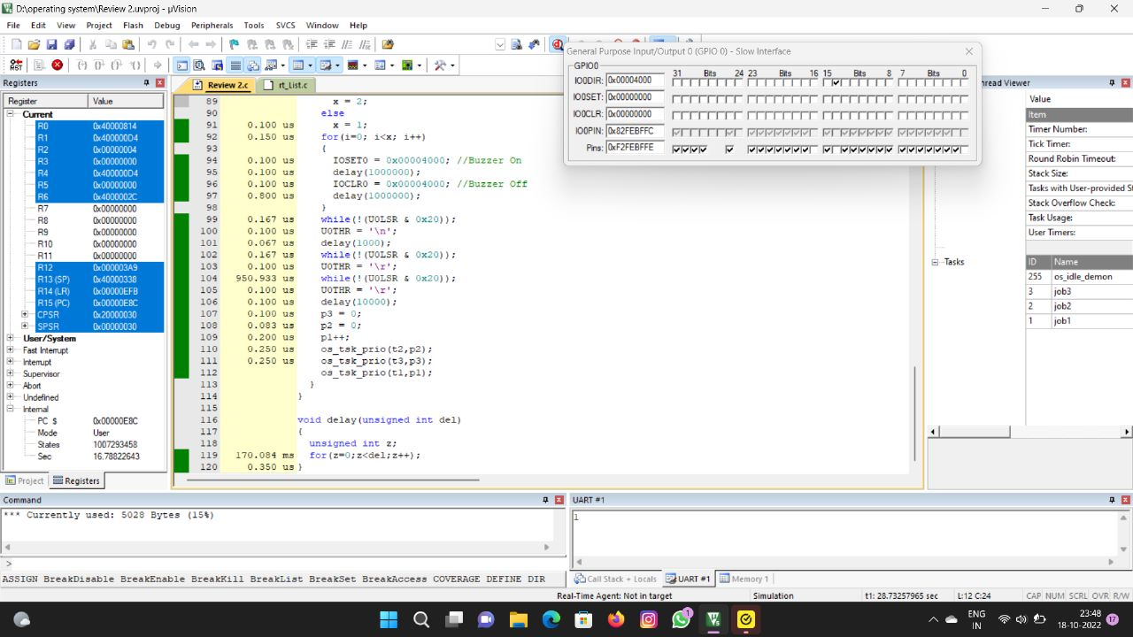
SoECE
Code Analysis:
Time analysis: 0.1969 seconds Memory analysis: 5028 bytes

Slide 9
SoECE
Thank You

